Slide 1
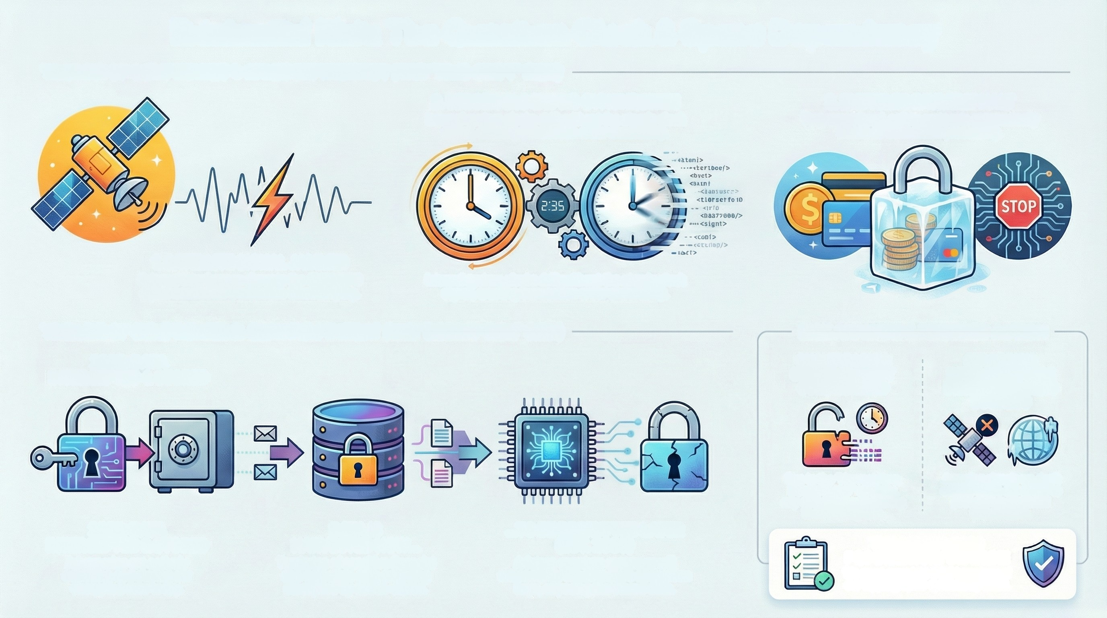
Existential Risk: The Quantum Clock & Space Dependency
TIMELINE OF COMPROMISE 1: SPACE DEPENDENCY (THE "TIME-DRIFT" RISK)
2. LEDGER CLOCKS DE-SYNCHRONIZE
internal system clocks drift without the atomic clock
signal, creating transaction order uncertainty.
3. SYSTEMIC PAYMENT HALT
To prevent fraud, safety protocols automatically
freeze all transaction processing.
1. SATELLITE SIGNAL JAMMED
External interference disrupts the GNSS/GPS
signal needed for transaction timestamping.
Internal system clocks drift without the atomic clock
signal, creating transaction order uncertainty.
TIMELINE OF COMPROMISE 2: QUANTUM THREAT (THE "DECRYPTION" RISK)
RISK ANALYSIS & REQUIRED ACTION
2025: DATA
QUANTUM RISK:
DATA IS ALREADY
COMPROMISED
SPACE RISK:
INFRASTRUCTURE
DISRUPTION HALTS
BUSINESS
INTERCEPTED & STORED
Due to the "Harvest Now,
Decrypt Later" strategy,
any data intercepted today
is effectively lost.
Jamming signals we don't
control stops our ability to
process any financial
transactions.
2025: DATA
INTERCEPTED & STORED
Adversaries are actively
capturing and storing our
encrypted data today.
DATA IS
HARVESTED NOW...
Terabytes of sensitive financial
and corporate data are being
stockpiled by nation-states.
...TO BE DECRYPTED LATER
(EST. 2030)
A future quantum computer will
retroactively break today's encryption
keys, exposing the stored data.
THE ACTION: 2026
PQC INVENTORY DEADLINE
We must complete a full inventory of
our cryptographic systems by 2026.

Slide 2
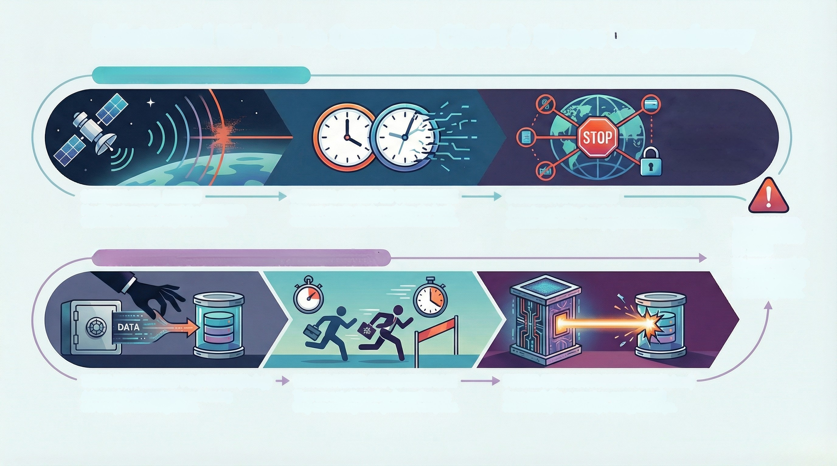
Existential Risk: The Quantum Clock & Space Dependency
THE SPACE DEPENDENCY: GNSS TIME-DRIFT
SYSTEMIC
PAYMENT HALT
Safety protocols automa-
halt all transactions to
prevent fraud, causing
a systemic outage.
SATELLITE SIGNAL JAMMED
Hostile actors can disrupt the GNSS/GPS
signals our systems rely on for time.
FINANCIAL LEDGERS DE-SYNCHRONIZE
Without atomic clock precision, the bank
cannot safely order financial transactions.
SYSTEMIC PAYMENT HALT
Jamming satellite signals triggers an automatic,
system-wide halt to our payment processing.
THE DEADLINE:
PQC INVENTORY
BY 2026
We must complete
a full inventory of
our cryptographic
systems by 2026.
THE QUANTUM THREAT: HARVEST NOW, DECRYPT LATER (HNDL)
TODAY: DATA INTERCEPT & STORAGE (Today)
Adversaries are capturing and storing
our encrypted data right now.
WAITING PERIOD: THE QUANTUM RACE
They are not attempting decryption yet;
they are waiting for a quantum computer.
FUTURE: RETROACTIVE DECRYPTION (Future)
Once available, a quantum computer will
retroactively break today's encryption keys.

Slide 3
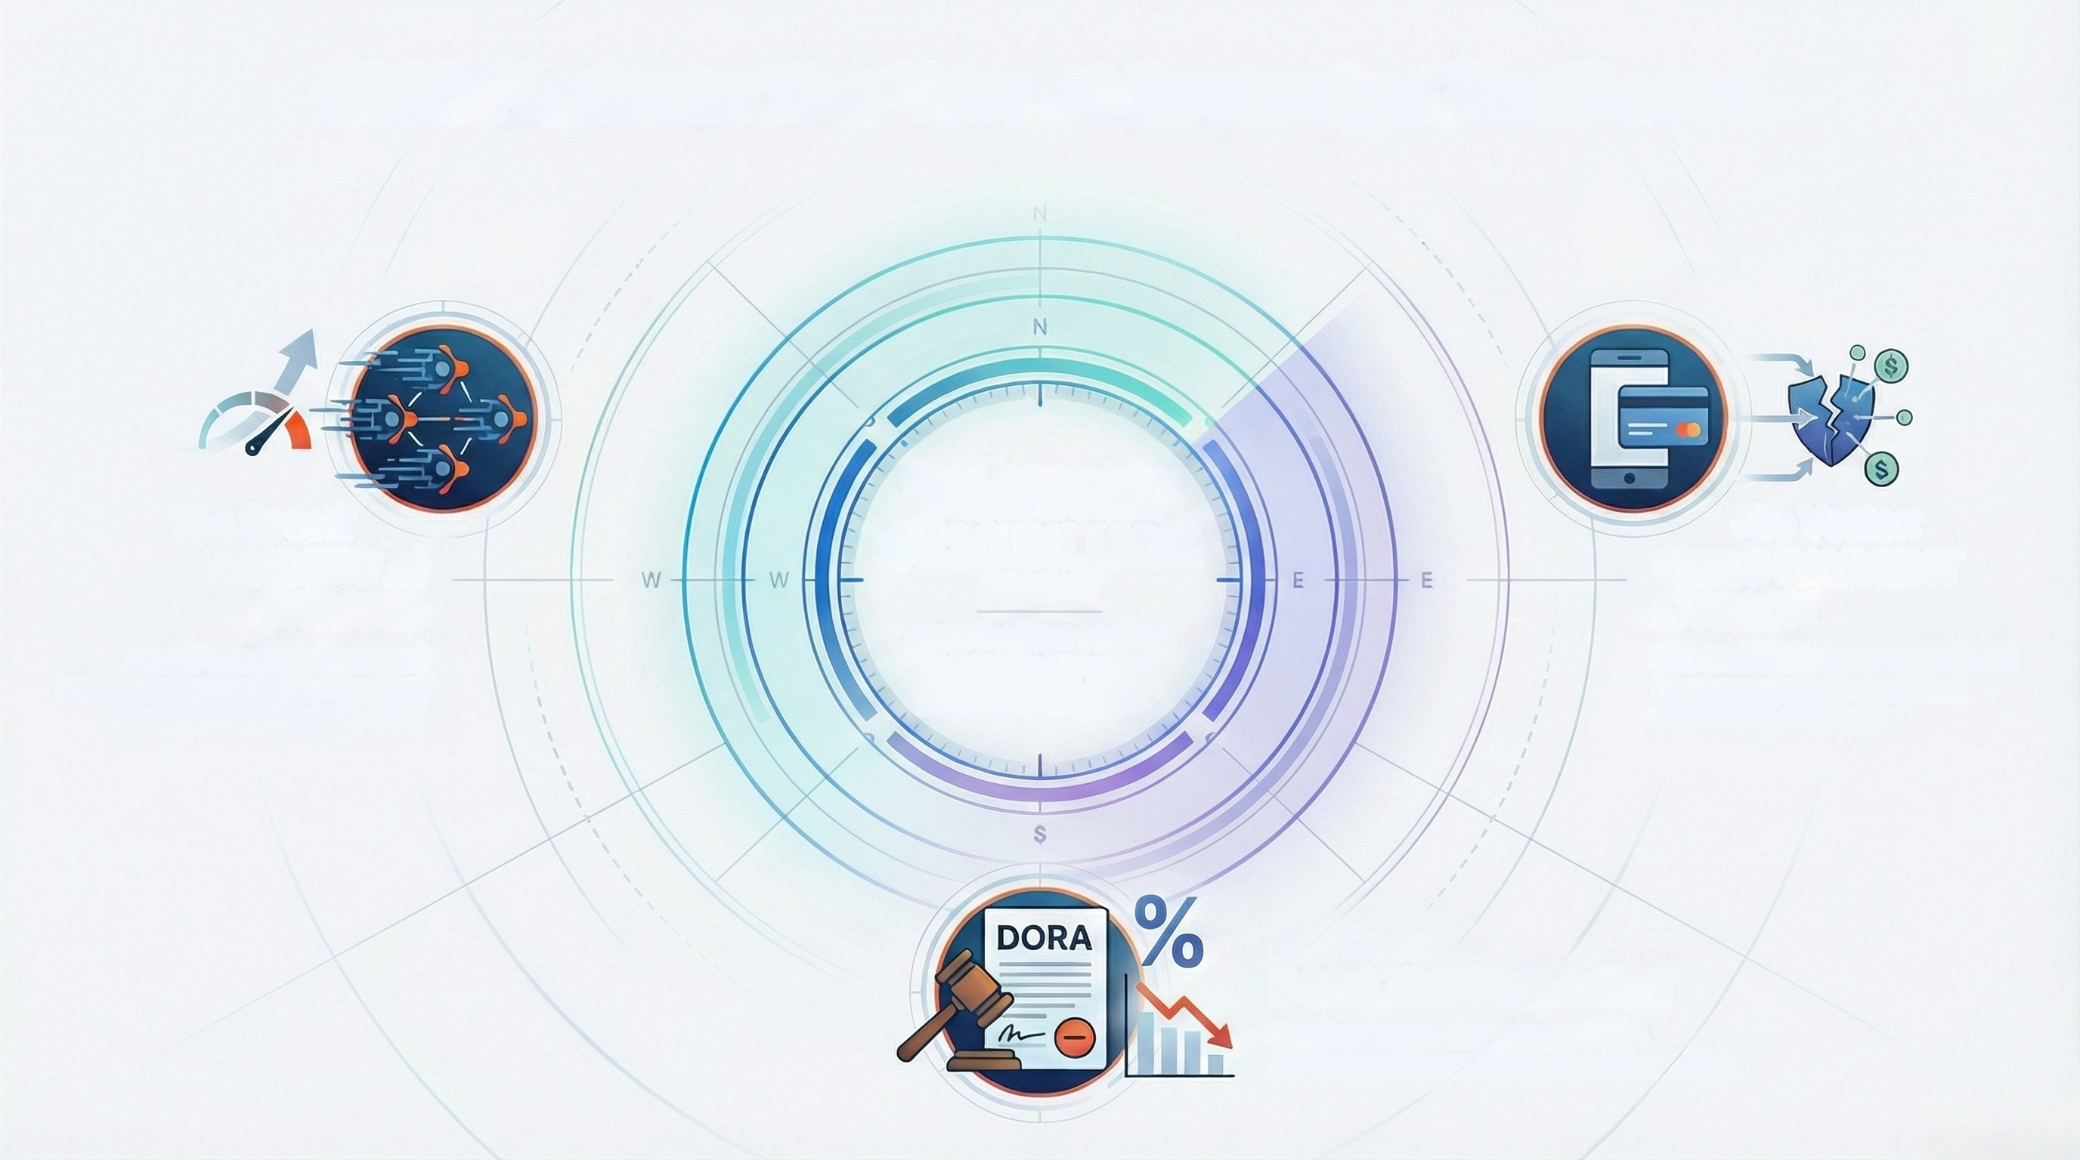
2026 Horizon: The Year of Sovereign Resilience
GLOBAL CYBERSECURITY
SPENDING TO EXCEED
$520 BILLION
The Speed:
AGENTIC AI
SWARMS
The Vector:
WERO PAYMENT
LAUNCH
The H1 2026 launch is predicted
to cause a spike in targeted
fraud across Europe.
ANNUALLY
Attack velocity will exceed
human response times, requiring
an automated Agentic SOC.
2028 STRATEGIC CONTEXT
Key drivers include regulatory
compliance (DORA), Al threat
mitigation, and third-party risk.
The Cost:
DORA ENFORCEMENT
The first 'maga-fines' under DORA
(up to 2% of turnover) are expected in 2026.

Slide 4
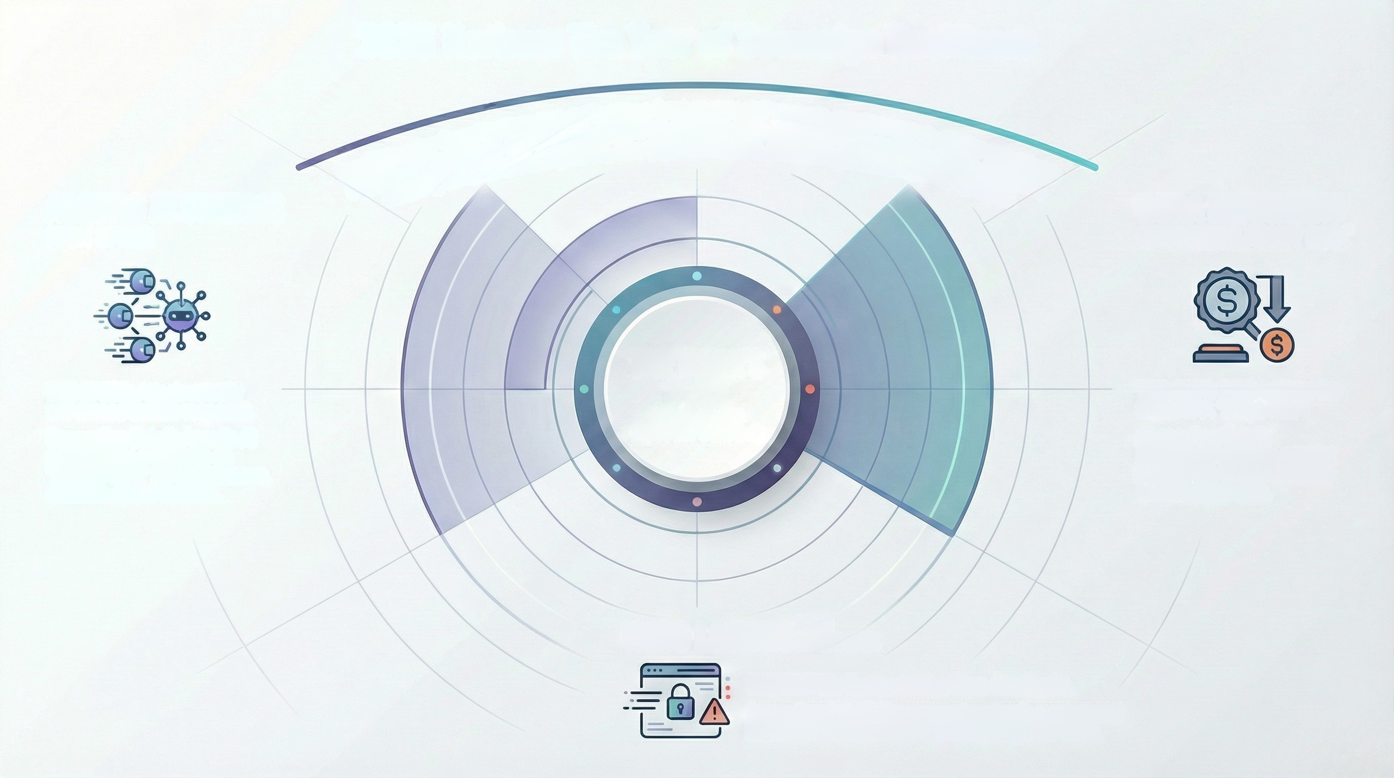
2026 Horizon: The Year of Sovereign Resilience
The 2028 cyber threat landscape is defined by a fundamental shift towards machine-speed attacks and severe
regulatory enforcement. Our strategic posture must evolve from perimeter defense to sovereign resilience,
focusing on autonomous systems, new payment vectors, and the high cost of non-compliance.
AGENTIC AI SWARMS
HIGH SPEED
DORA ENFORCERS
HIGH REGULATORY RISK
THE BANK'S
THE SPEED: Attack velocity
will exceed human response.
Supporting Detail: Agentic Al
necessitates a move to an
"Agentic SOC" for autonomous,
machine-speed defense.
CORE
THE COST: 2026 will see the
first DORA "Mega-Fine".
Supporting Detail:
Regulators will levy a major
penalty (up to 2% tumover)
to set a precedent.
($520 BILLION
INDUSTRY CONTEXT)
WERO LAUNCH FRAUD RISK
THE VECTOR: Europe faces a Wero fraud spike.
Supporting Detail: The payment system's e-commerce
launch in H1 2026 will be a primary target for fraud.

Slide 5
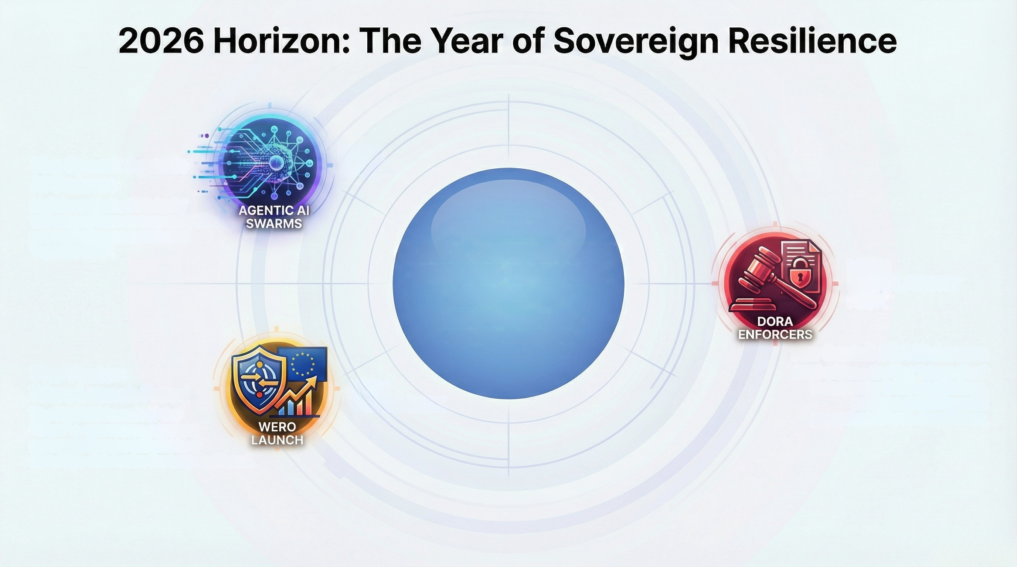
The Speed: Agentic
HIGH
SPEED
Al Swarms
Malicious Al attack velocity
will exceed human response times,
necessitating an automated
"Agentic SOC".
THE BANK'S CORE
GLOBAL CYBERSECURITY
SPENDING TO EXCEED
$520 BILLION
Industry context driving
strategic imperative
HIGH
REGULATORY
RISK
The Cost: DORA Enforcers
2026 will see the first "Mega-Fine"
levied under DORA regulations,
setting a major financial
precedent for non-compliance.
The Vector:
Wero Launch Fraud
The H1 2026 launch of the
HIGH
FRAUD RISK
"Wero" e-commerce payment
system in Europe will create a
new, high-risk vector for targeted fraud.

